Slide 1
Blue River Nutrient Enhancement Project
Brien Rose
Blue Valley Ranch
Kremmling, CO

Slide 2
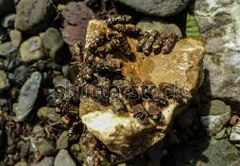
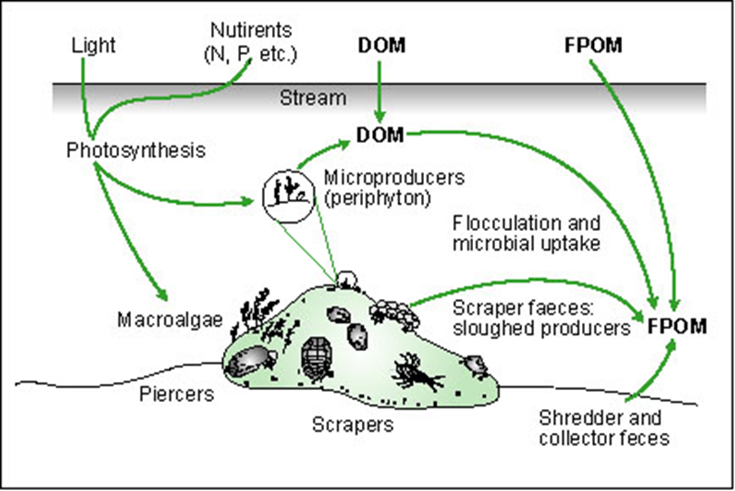
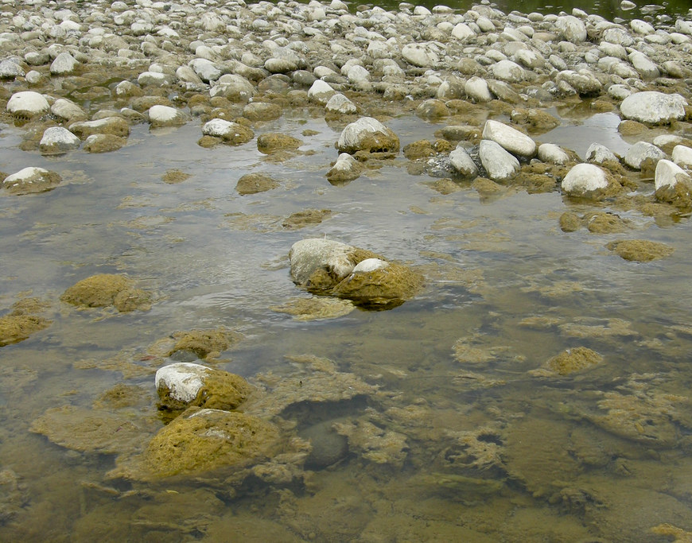
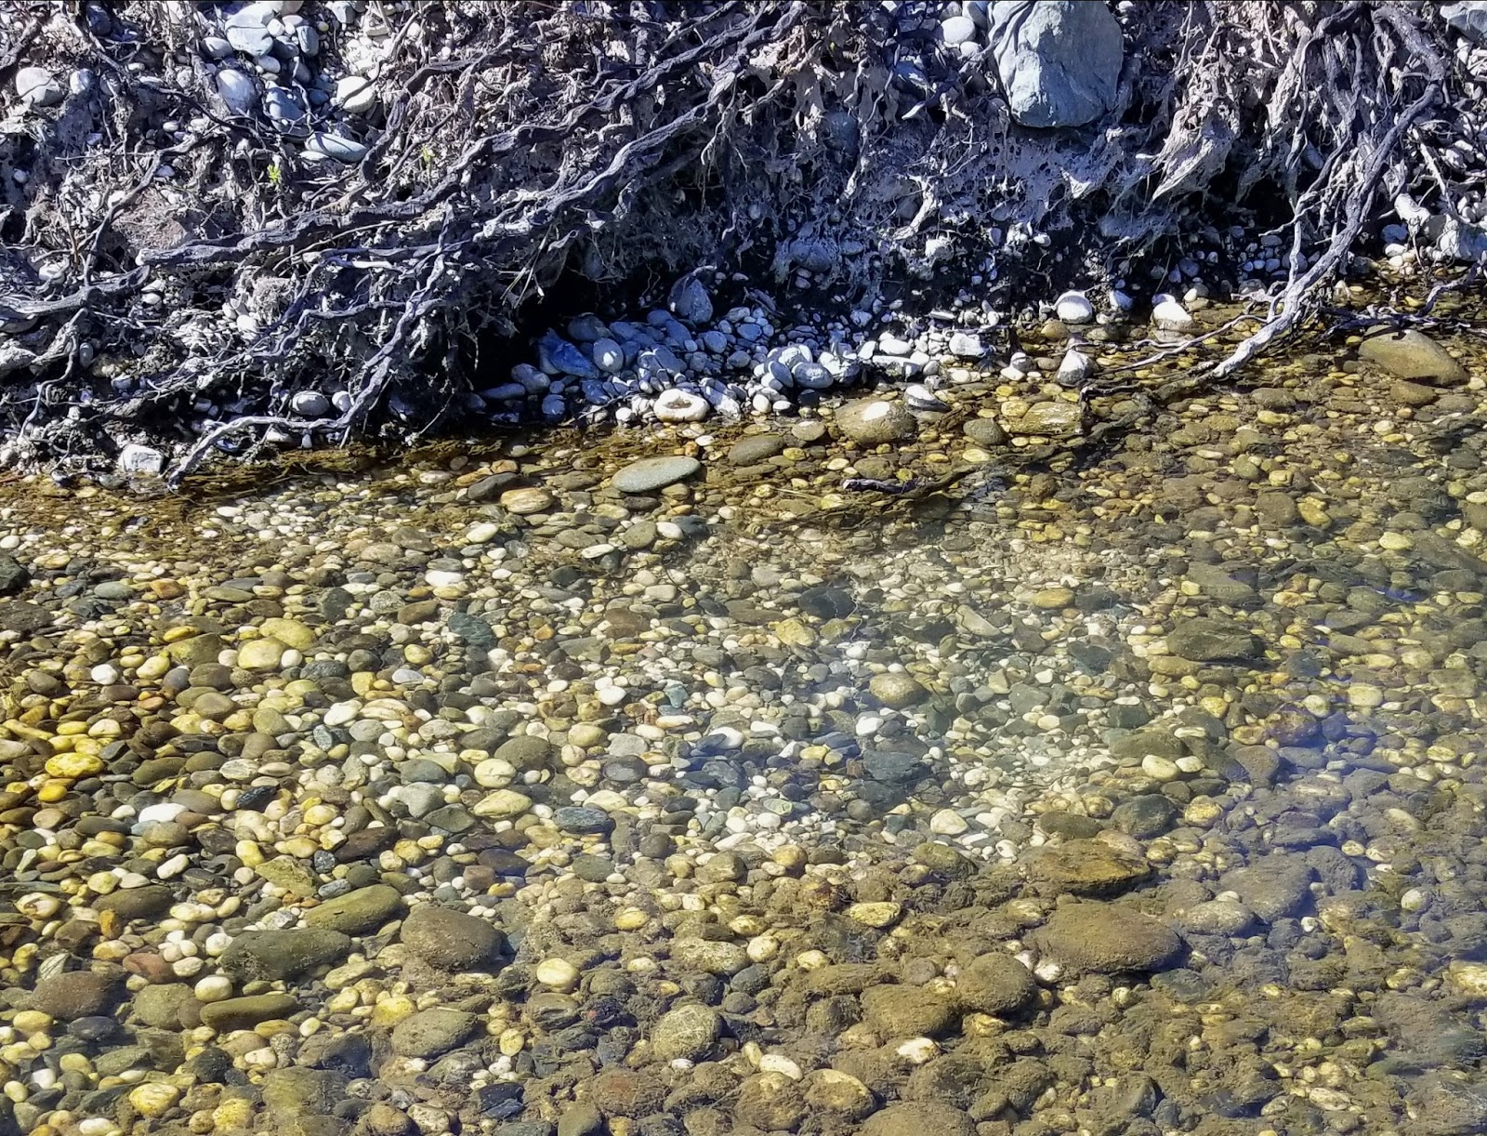
Goals
“Ecosystem based study to evaluate the role of Phosphorus (P) in Primary and Secondary production in the Lower Blue River”
  Evaluate present conditions
  Experimentally increase Phosphorus levels
  Evaluate the response of Primary and Secondary producers to increased Phosphorus levels.
  Evaluate the response of Didymo algae to increase levels of Phosphorus

Slide 3
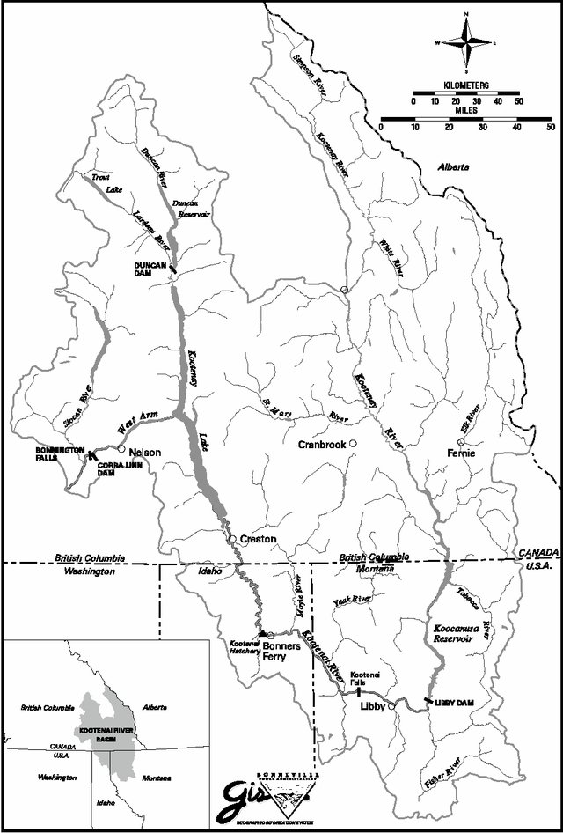
Relation to other projects
Kootenai River, Idaho (10x the size of the Blue River)
Added 10-34-00 Fertilizer (6,000-20,000 gallons per year)
Gallons per Year

Slide 4
Results of Kootenai River study
Kootenai River, Idaho

Slide 5
Total DIN Below Green Mountain
(CDPHE= 1,250 ug/l)
High levels of DIN
No Seasonal variations
Lower than above GMR
Below WQ standards
(Mean Above GMR = 233 ug/l)
(Mean = 213 ug/l)
(Mean= 195 ug/l)
KR=64 ug/l
(Mean = 242 ug/l)

Slide 6
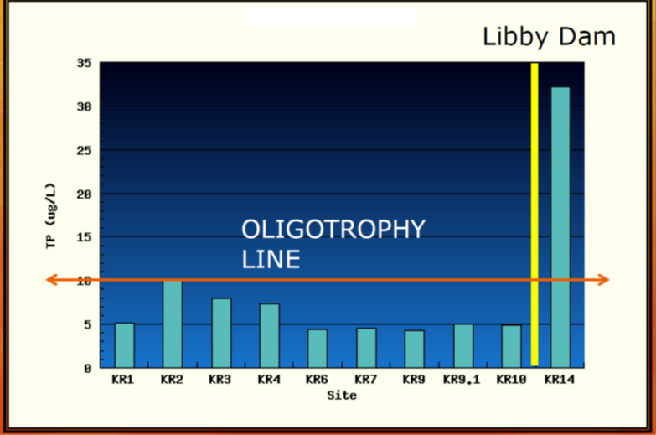
Total Phosphorous Below Green Mountain
(CDPHE= 110 ug/l; Not regulated)
Mostly Oligotrophic
Seasonal variations
  Higher with snowmelt
27% < than values above GMR
Mostly below standard detectability levels
(Mean = 6.6 ug/l)
(Mean = 7.9 ug/l)
(Above Green Mountain = 9.0 ug/l)
-Oligotrophy Line
-EPA detection
limit)
KR=7.9 ug/l

Slide 7
Dissolved Phosphorous Below Green Mountain
(Unregulated)
Seasonal variations
  Higher with snowmelt
Little variation between sites
(Mean = 3.5 ug/l)
(Mean = 3.3 ug/l)
(Above Green Mountain = 3.3 ug/l)
KR=3 ug/l

Slide 8
Soluble Reactive P Below Green Mountain
(Unregulated)
Most important variable
  “what’s available for plants”
No clear patterns
Nutrient Poor
(Mean ≈ 1.0 ug/l)
(Mean ≈ 1.0 ug/l)
(Above Green Mountain ≈ 1.0 ug/l)
Goal =3 ug/l
KR=<1 ug/l

Slide 9
Phosphorous to nitrogen ratios
P limited Streams
KR=27
P limited Streams
Balanced P:N
Balanced TDP:TDN

Slide 10
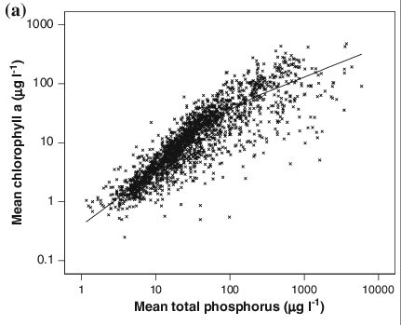
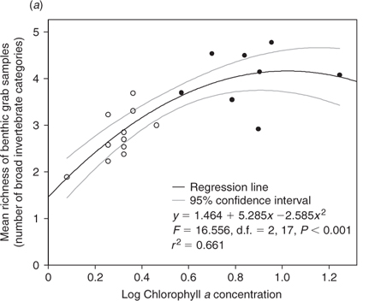
Importance of Phosphorus
SRP Values; Blue River ≈ 1.0
Blue River
From Hill et al 2009

Slide 11
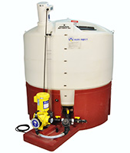
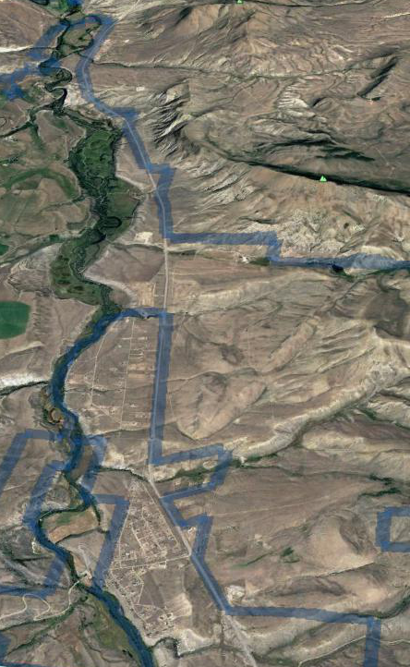

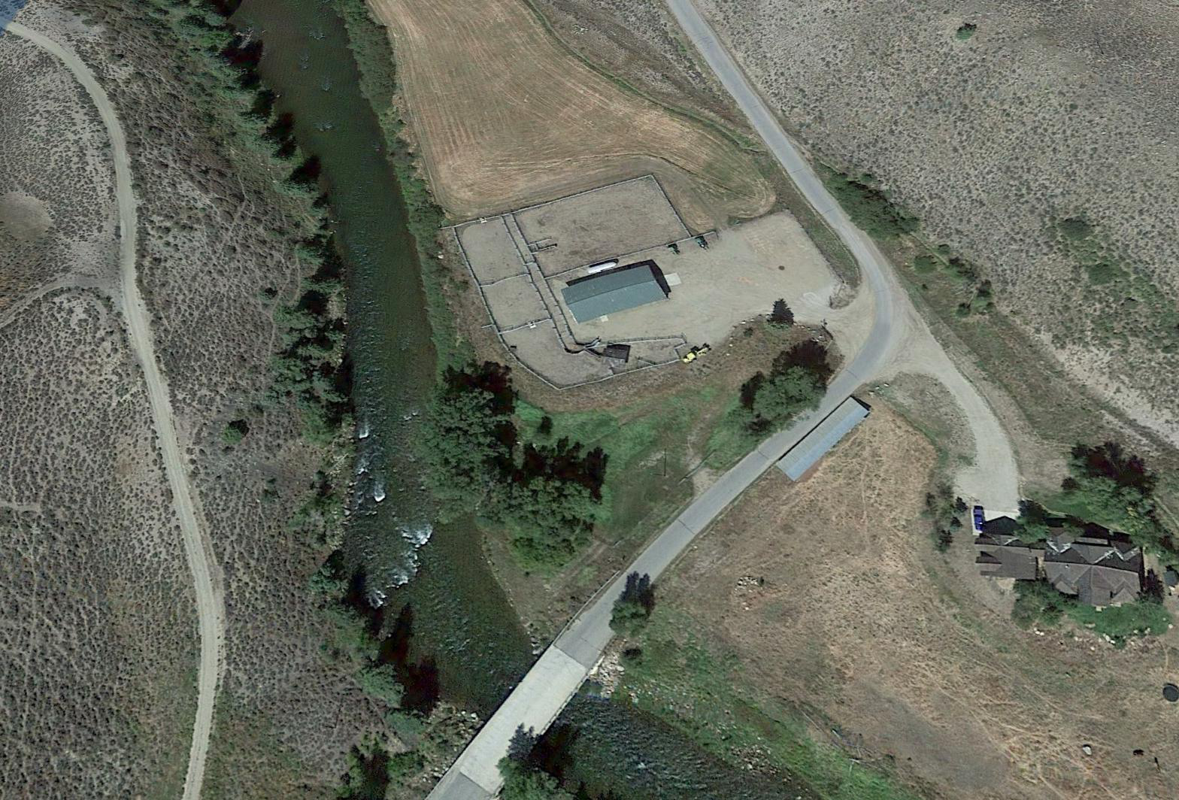
Injections Site and Methods
2,000-3,000 Gallons per year
Each Reach
7 Reaches
  Periphyton and invertebrates
  spaced over 7 miles
4 Water Quality Stations
  Spring Creek Rd to Trough Rd
7 Fry stations (3-4 times per year)
1 Adult Population and Condition survey
Injection Site
Control Site

Slide 12
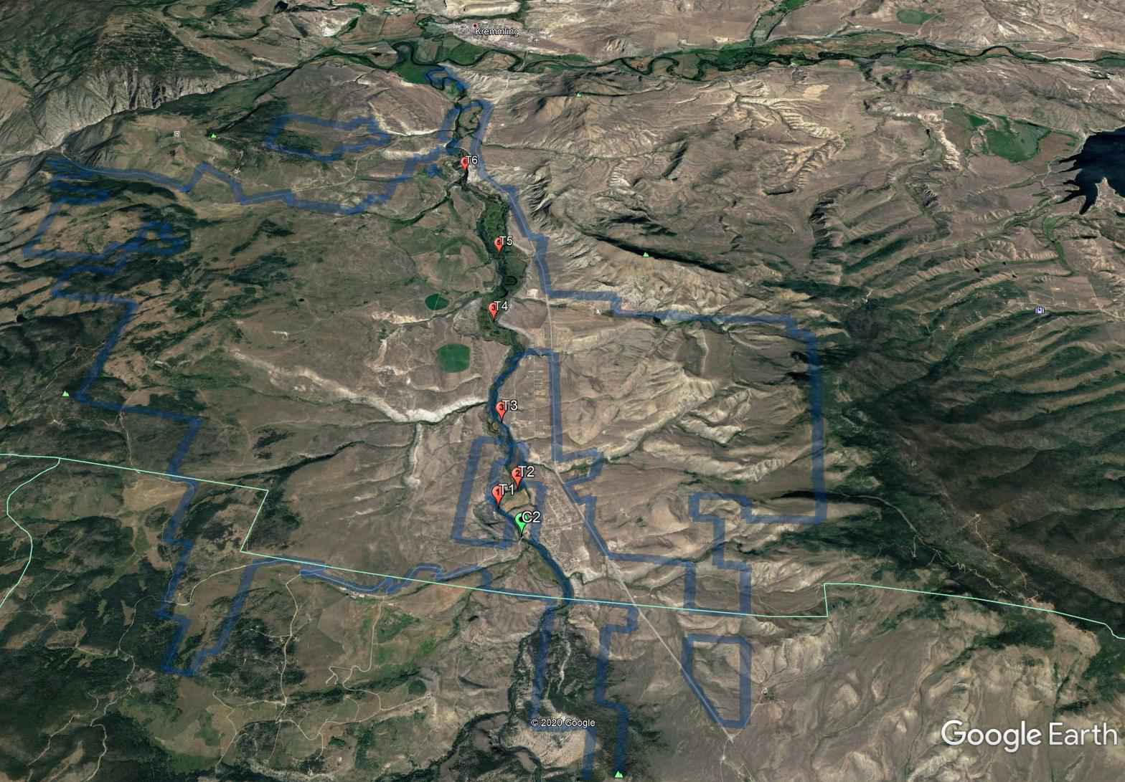
Study Methods—Producers
Each Reach
Invertebrates
(2 samples composite of3 sites )
Periphyton
(AFDM + CL-A)
Growth
Tiles (N=2)
Standing Crop (Rocks)
Spring
Summer/Fall
Winter/Spring
Bi-Monthly
Summer
30 Day
Fall
60 Day
90 Day

Slide 13
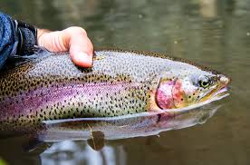
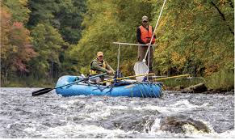
Study Methods—Fish
Fish >200mm
Trout Fry + Sculpin
Raft Shocker
(2,100 m “Wild Water)
7 Sites with Backpack Shocker
Population
Relative Weight
Monthly (August-November)
Population
Growth

Slide 14
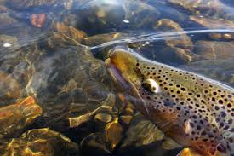
Questions??

